Slide 1
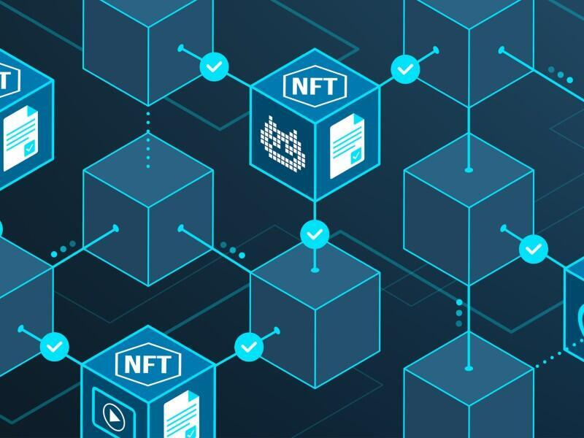
Blockchain Based NFT Platform

Slide 2
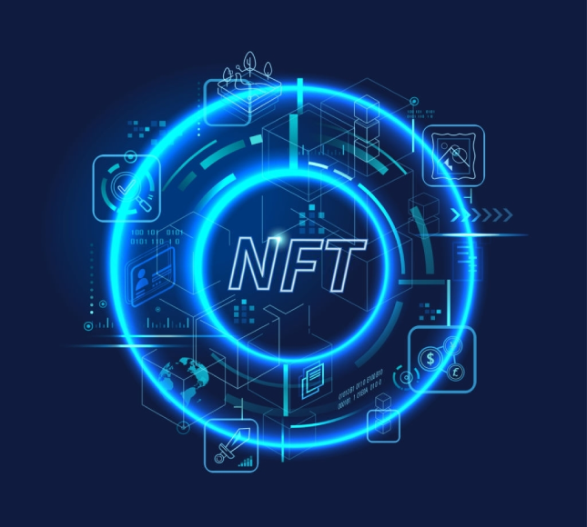
GUIDE AND TEAM
GUIDED BY:
Dr. D. Sumathi
TEAM:
AMIT KUMAR SAHU -18MIS7250
S.V.SURYA VAMSI -18MIS7211
P.VARSHINI -18MIS7035

Slide 3
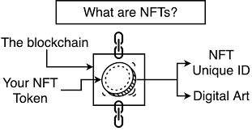
INTRODUCTION:
NFTS are non-fungible tokens.
Unique cryptographic tokens that exist on a blockchain and cannot be replicated.
Irreplaceable and provide exclusive ownership on the blockchain.
Can be anything digital, such as piece of art or drawings or music.
NFTS can represent real-world items like artwork.
“Tokenizing” this real world tangible assets makes buying, selling and trading them more efficient while reducing the probability of fraud.

Slide 4
OBJECTIVE
The main aim of the project is to build an open digital economy with a new type of digital goods called Non-fungible tokens and create a marketplace where we can sell and buy an digital art.
NFTs are unique cryptographic tokens that exist on a blockchain and cannot be replicated.
we’re excited about a brand new type of digital goods called non-fungible tokens or NFTs.
It wouldn’t probably make a lot of sense to build an application where you’re trading in assets that are two to ten dollars on ethereum because the transaction itself costs more than that and transactions per second are slow but working on scalable solutions Like polygon transaction fee is lesser and faster.

Slide 5
SMART CONTRACTS
Review 1
A smart contract is a tool to implement a sale agreement between the NFT owner and the buyer, like a vending machine.
Smart contracts, being self-executing, are able to verify that the terms of the contract have been met and execute the terms without the need of an intermediary or central authority.

Slide 6
Technologies Used
Review 1
Polygon Network (Blockchain Network)
Next.js (Backend framework)
HTML & CSS
Solidity (blockhain based programming language)
IPFS (InterPlanetary File System)
Ethers.js (to interact with Ethereum blockchain)
Hardhat (Smart contracts simulation)

Slide 7
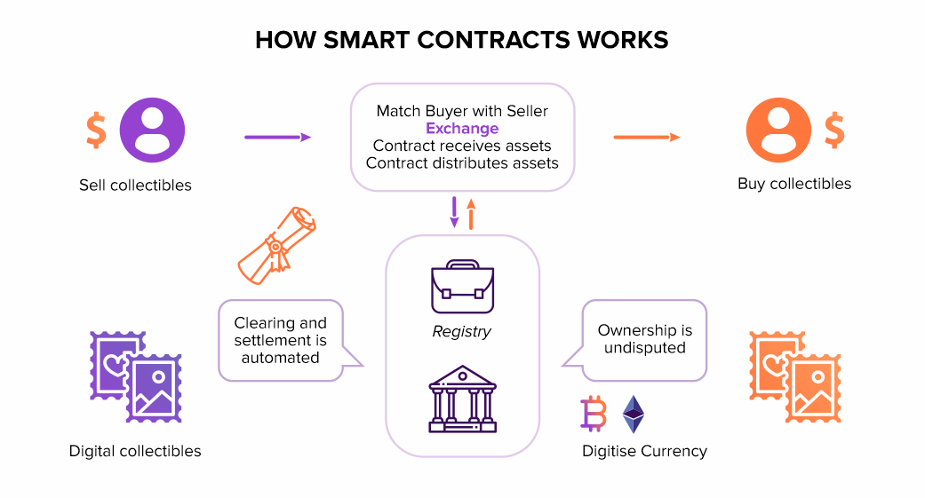
Review 1

Slide 8
Code Snippets
Review 1
struct MarketItem {
uint itemId;
address nftContract;
uint256 tokenId;
address payable seller;
address payable owner;
uint256 price;
bool sold;
}
mapping(uint256 => MarketItem) private idToMarketItem;
event MarketItemCreated (
uint indexed itemId,
address indexed nftContract,
uint256 indexed tokenId,
address seller,
address owner,
uint256 price,
bool sold
);
/* Returns the listing price of the contract */
function getListingPrice() public view returns (uint256) {
return listingPrice;
}
// SPDX-License-Identifier: MIT OR Apache-2.0
pragma solidity ^0.8.3;
import "@openzeppelin/contracts/utils/Counters.sol";
import "@openzeppelin/contracts/security/ReentrancyGuard.sol";
import "@openzeppelin/contracts/token/ERC721/ERC721.sol";
import "hardhat/console.sol";
contract NFTMarket is ReentrancyGuard {
using Counters for Counters.Counter;
Counters.Counter private _itemIds;
Counters.Counter private _itemsSold;
address payable owner;
uint256 listingPrice = 0.025 ether;
constructor() {
owner = payable(msg.sender);
}

Slide 9
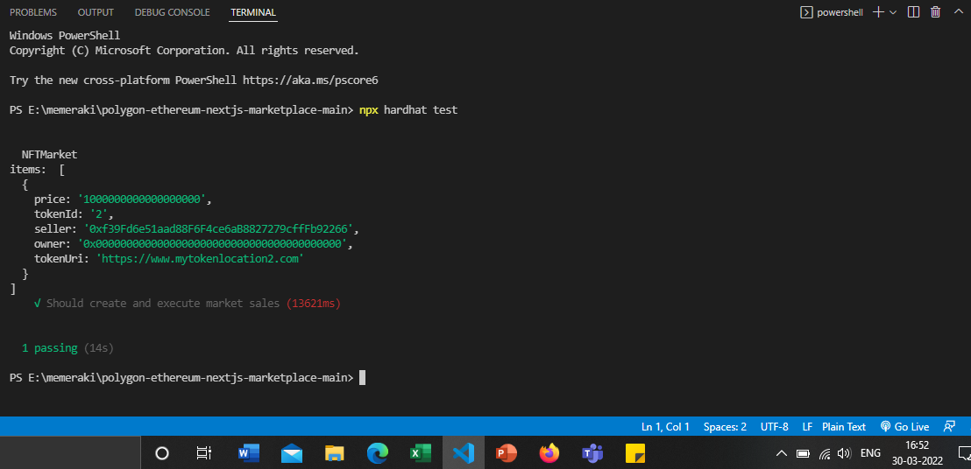
Testing Smart Contract for Marketplace
Review 1

Slide 10

